Slide 1


Slide 2

^{The Service Design Network}

Slide 3


^{STRATEGY}

Slide 4
^{SDN MISSION}
Our mission is to grow the market for service design and enable opportunities for our members to create better and more human services worldwide.
We believe that a greater demand for the practice will positively influence the communities of research, education, and practice. We are a platform for exchange, communication, and support for the diverse service design community.

Slide 5
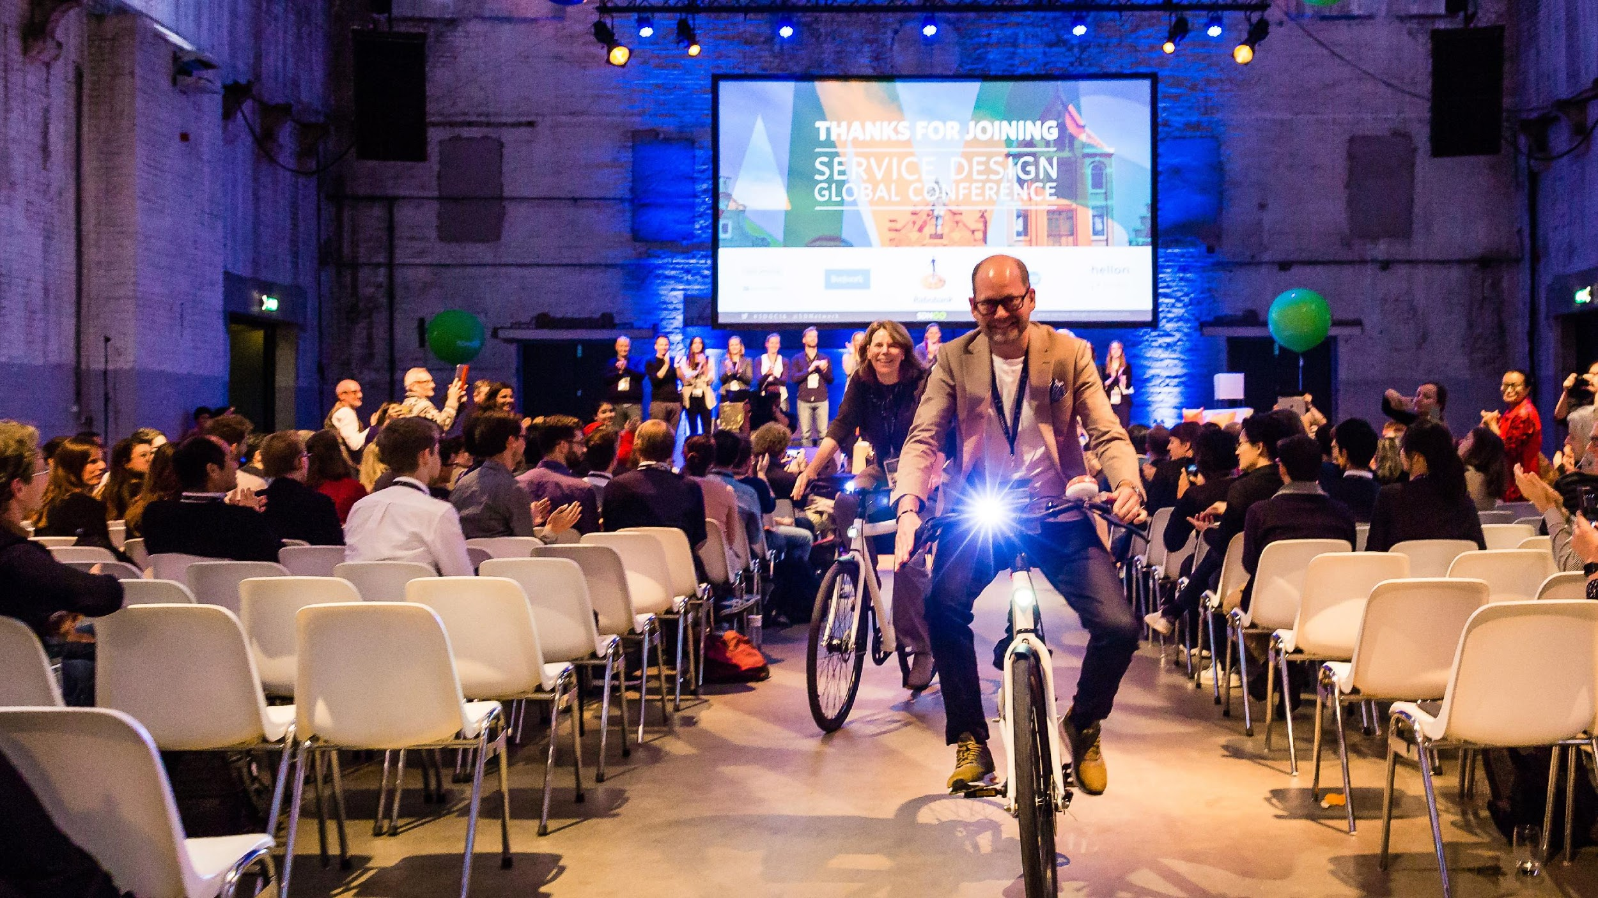

What do we do?
@SDNetwork
www.service-design-network.org
Notes:
Change the background

Slide 6



We connect you with like-minded, passionate service designers from companies, agencies and academia. We equip you to create better services and raise awareness about service design.
Volunteer-led
organisation
43
international chapters
A community with over 10 years of expertise

Slide 7




Facilitate knowledge exchange
Create relevant content
Recognise & celebrate
best practice
Raise awareness
& grow service design
Connect the
international community
Enrich the local
SD community
@SDNetwork
www.service-design-network.org

Slide 8




Conference & events discounts
^{MEMBER}
^{EXCLUSIVE}
^{BENEFITS}
Case study
library
Participate in exclusive
Members Events
Touchpoint
Journal
Your
profile on SDN site
Podcasts &
community knowledge
@SDNetwork
www.service-design-network.org

Slide 9
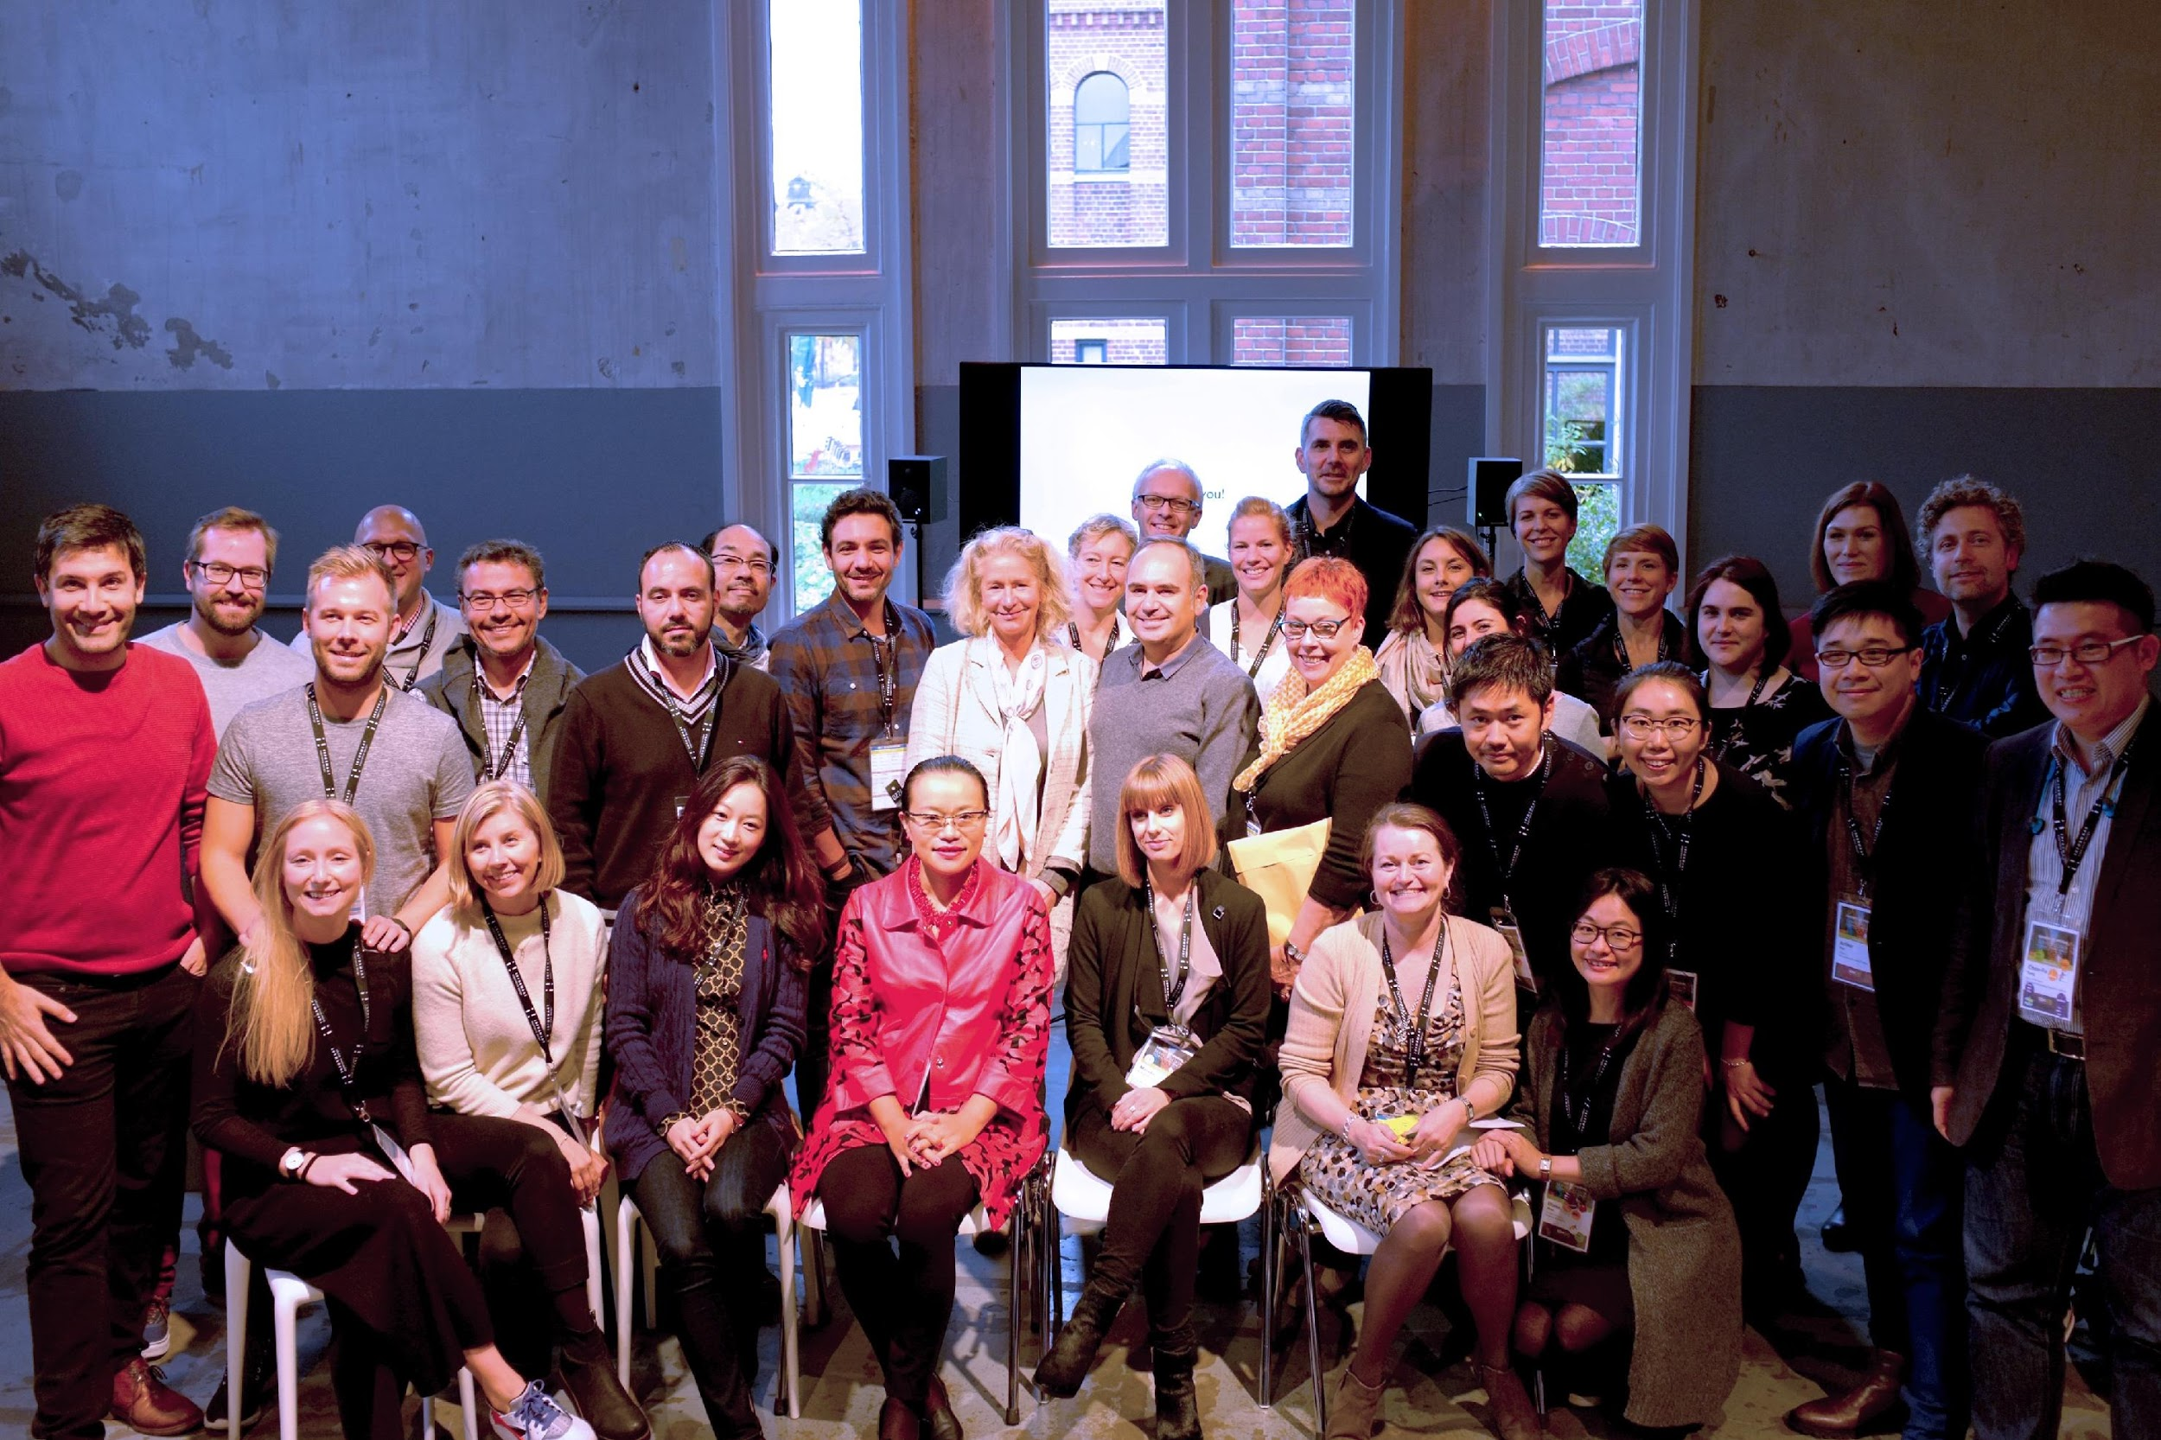
Who are we?
@SDNetwork
www.service-design-network.org

Slide 10
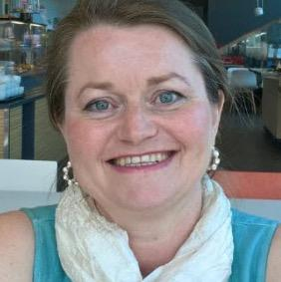



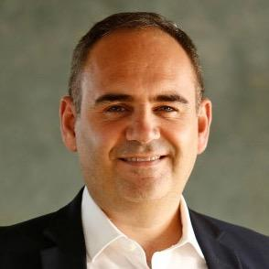
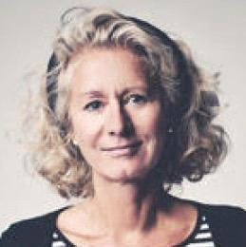
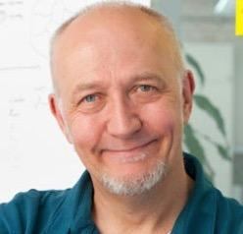
MANAGEMENT BOARD
Tarja Chydenius
Service Design Network
Laurea University Of
Applied Sciences
Shelley Evenson
Service Design Network
Fjord
Jesse Grimes
Service Design Network
Informaat
Jamin Hageman
Service Design Network
Capital One
Yigit Kulabas
Service Design Network
RE / Design Business
Birgit Mager
Service Design Network
KISD
Alex Nisbett
Service Design Network
Designit

Slide 11


EVENTS BOARD
NATIONAL CHAPTER BOARD
Alex Nisbett
Service Design Network
Designit
Jamin Hageman
Service Design Network
Capital One
Tarja Chydenius
Service Design Network
Laurea University Of
Applied Sciences
Atsushi Hasegawa
Service Design Network Concent
Ruth Watson
Service Design Network
Nile

Slide 12
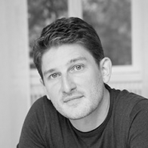
MEDIA BOARD
SPECIAL INTEREST BOARD
Jesse Grimes
Service Design Network
Informaat
Stefan Moritz
Service Design Network
Veryday
Shelley Evenson
Service Design Network
Fjord

Slide 13
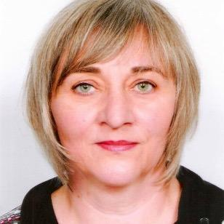



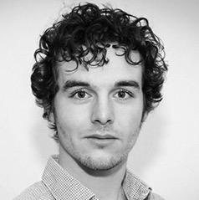


SDN GLOBAL TEAM
Karin Henz
Service Design Network
Cristine Lanzoni
TH Köln
Leila Marchetti
TH Köln
Alicia Shao
KISD
Samuel Simon
Service Design Network
Eloise Smith-Foster
TH Köln
Kelly Teunissen
Service Design Network

Slide 14
^{SERVICE DESIGN NETWORK}
^{Achievements 2017}

Slide 15
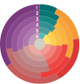
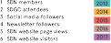
^{MEASURING IMPACT AND VALUE}

Slide 16

^{MEMBERS}

Slide 17
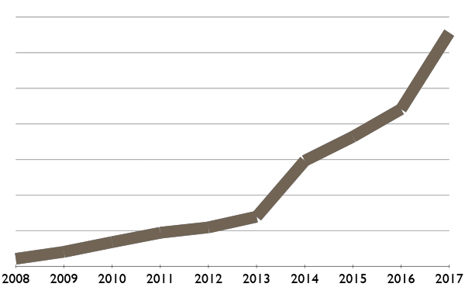
^{INTERNATIONAL MEMBER GROWTH}
1,312
883
728
583
279
219
136
189
43
82

Slide 18
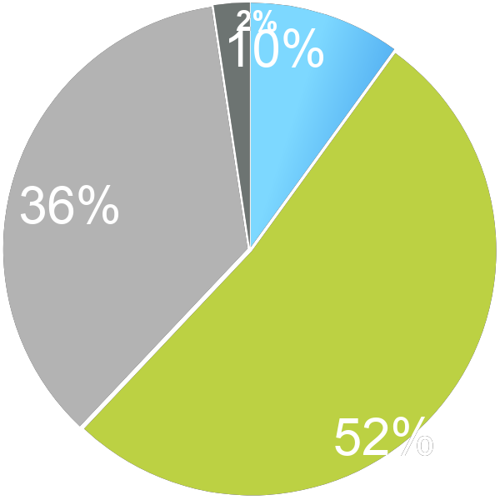
^{MEMBER TYPE OVERVIEW}
31 Academic
131 Student
467 Corporate
683 Professional

Slide 19
10,274
TOTAL Members + Community followers

Slide 20
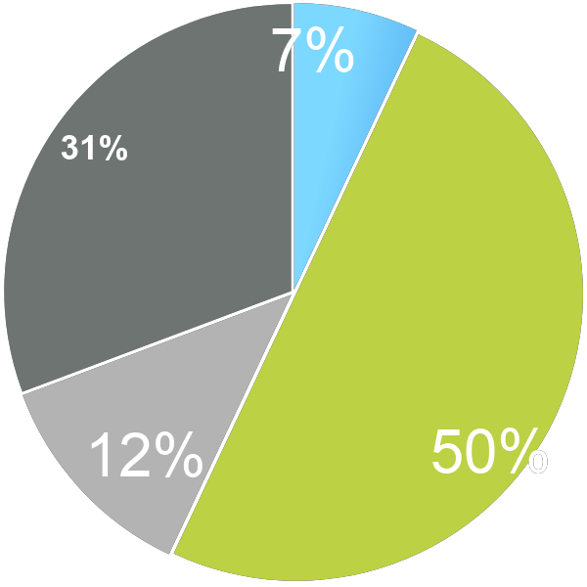
^{GERMANY MEMBER TYPE OVERVIEW}
8 Student
35 Corporate Invitees
57 Professional
14 Corporate

Slide 21

^{CHAPTERS}
Tarja Chydenius
Eloise Smith-Foster

Slide 22






Slide 23

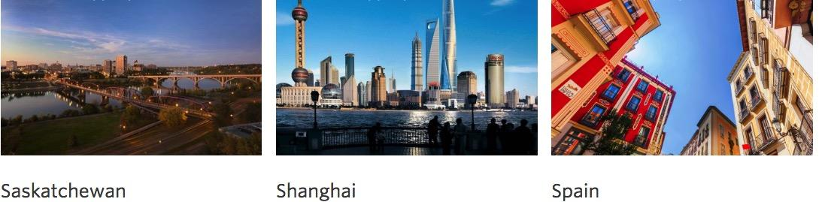


Slide 24

^{EVENTS}
Jamin Hegeman, Alex NisbettLeila Melina Marchetti,
Janina Rösch, Eloise Smith-Foster, SDN Chapters

Slide 25










^{GLOBAL CONFERENCES}
AMSTERDAM 2008
MADEIRA 2009
BERLIN 2010
SAN FRANCISCO 2011
PARIS 2012
CARDIFF 2013
STOCKHOLM 2014
NEW YORK 2015
AMSTERDAM 2016
MADRID 2017

Slide 26





^{CHAPTER EVENTS}

Slide 27

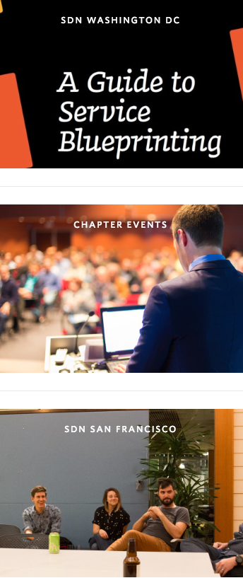

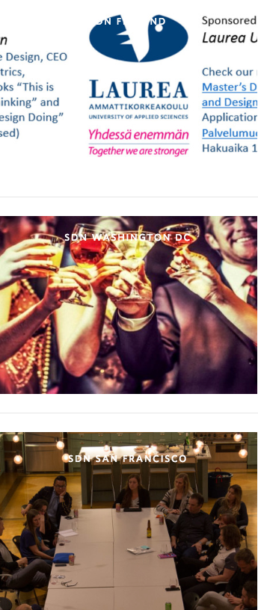
^{CHAPTER EVENTS}

Slide 28


^{SERVICE DESIGN DAY - JUNE 1st}
Celebrating
service design
Raising
awareness
Bringing the
community together
Notes:
Changed the position of the sentences
The more members we have the bigger will be the impact.

Slide 29
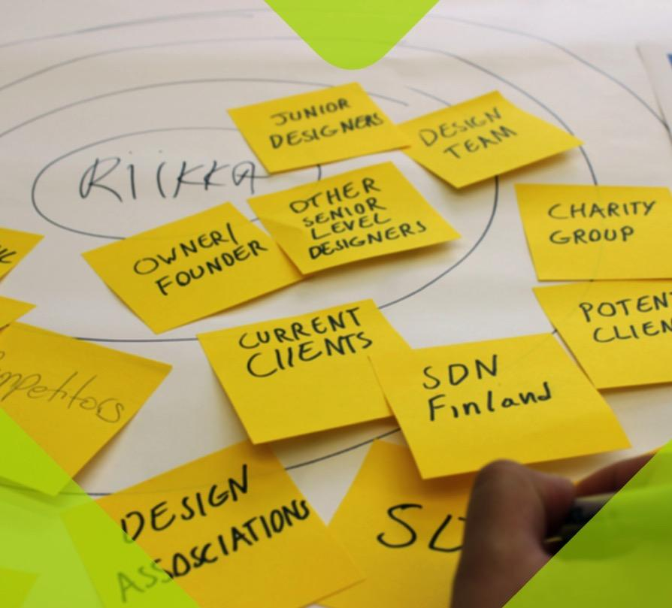



^{How can I get involved?}
Share activities using #ServiceDesignDay
Share service moments
Celebrate!
Tag a touchpoint
Share the SDDay sign

Slide 30
^{CHANNELS}
Yigit Kulabas Samuel Simon, Kelly Teunissen

Slide 31

^{NEW SDN COMMUNITY SLACK}
Join the international conversation!
For SDN Community Followers and Members

Slide 32

^{SDN WEBSITE}
540,322 Page views 103,647 Visitors

Slide 33



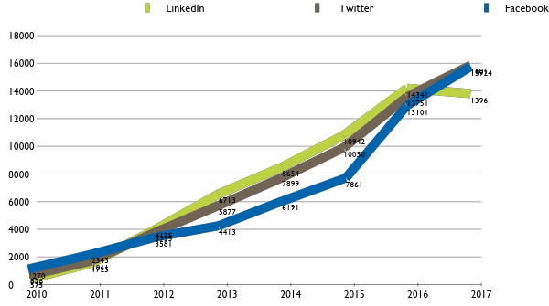
^{SOCIAL MEDIA GROWTH}

Slide 34
45,896
TOTAL audience following our
social media activities

Slide 35
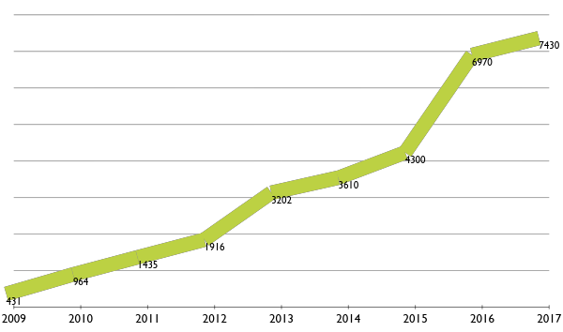
^{INSIDER NEWSLETTER}
7430
6970
4350
3610
3202
1916
1435
964
431

Slide 36

^{TOUCHPOINT JOURNAL}
Jesse Grimes - Editor-in-Chief
Cristine Lanzoni

Slide 37





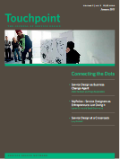











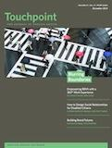









^{TOUCHPOINT JOURNAL}
Vol. 3
Vol. 1
Vol. 2
2011
Vol. 4
Vol. 5
2013
Vol. 6
Vol. 7
Vol. 8
Vol. 9
Special Edition

Slide 38

^{TOUCHPOINT JOURNAL}

Slide 39
^{Special Interest Groups}
Birgit Mager, Shelley Evenson
Aline Alonso

Slide 40



^{IMPACT REPORTS}
2015 Financial Services
2016 Public Sector
2017 Health Sector
@SDNetwork
www.service-design-network.org

Slide 41

^{SERVICE DESIGN AWARD}
Kerry Bodine - Head of the Jury Eloise Smith-Foster

Slide 42


over 30 nationalities represented 14 shortlisted projects

Slide 43

^{TRAINER ACCREDITATION}
Birgit Mager - Head of Committee
Cristine Lanzoni

Slide 44
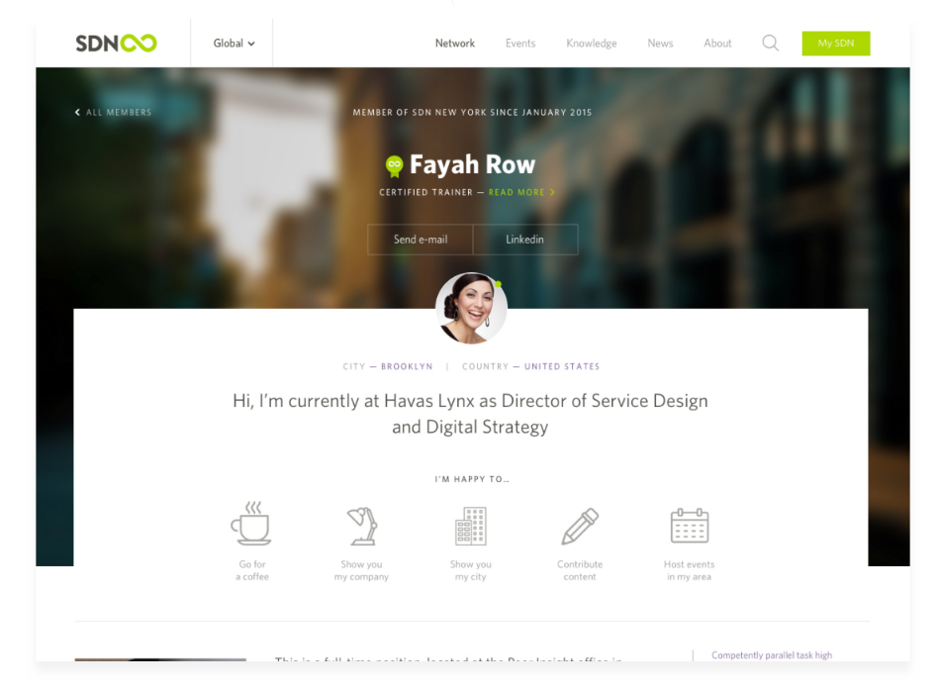
Become an SDN Accredited Service Design Trainer
An official accreditation initiative that will help establish a standard and ensure higher quality within the field

Slide 45
^{YOU !}

Slide 46

^{Actively engage!}
We welcome anyone who wants
to make a difference with
service design.
@SDNetwork
www.service-design-network.org
Notes:
Changed the position of the sentences
The more members we have the bigger will be the impact.

Slide 47
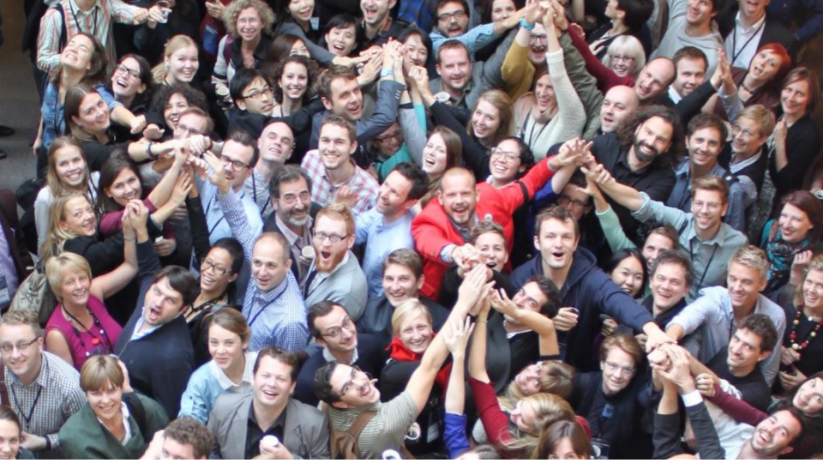

@SDNetwork
www.service-design-network.org

